Slide 1

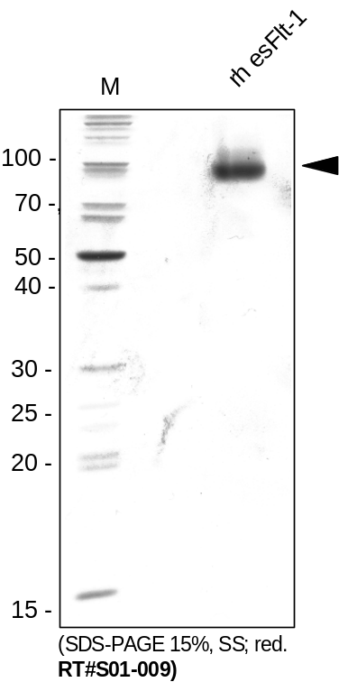
ReliaTech GmbH
Recombinant human endogenous soluble VEGFR-1/sFlt-1
(Cat #S01-009 / -010)
Fig. 1: SDS-PAGE analysis of recombinant human VEGFR-1/sFlt-1 (esFlt-1) produced in insect cells. Sample was loaded in 15 SDS-polyacrylamide gel under reducing conditions and stained with Silver stain.
http://www.reliatech.de / orders@reliatech.de

